Slide 1
JVM Architecture
In this video we will cover JVM Architecture, what are different blocks of JVM.
Use of Class Loader Subsystem (Loading, Linking, Initialization)
How .class file loaded in Runtime Data Area of JVM.
How interpreter will generate a machine understandable code, use of JIT(Just In Time) Compiler.
After this class I want you to think how class is loading in JVM

Slide 2
How JVM is Platform Independent
Java Compiler(javac) will convert .java file into .class file
This Bite Code (.class file) will then processed by JVM and converts the machine understandable code.
The .class file will execute on any operating system which has JVM in it.
But the JVM installed is platform dependent for each operating system.
The JVM is platform-dependent, meaning there are different JVMs for different operating systems, but the bytecode they execute is platform-independent.

Slide 3
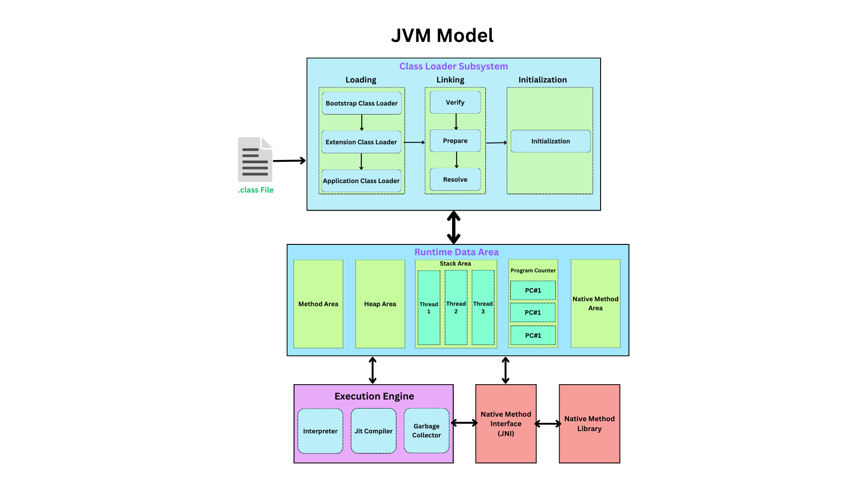

Slide 4
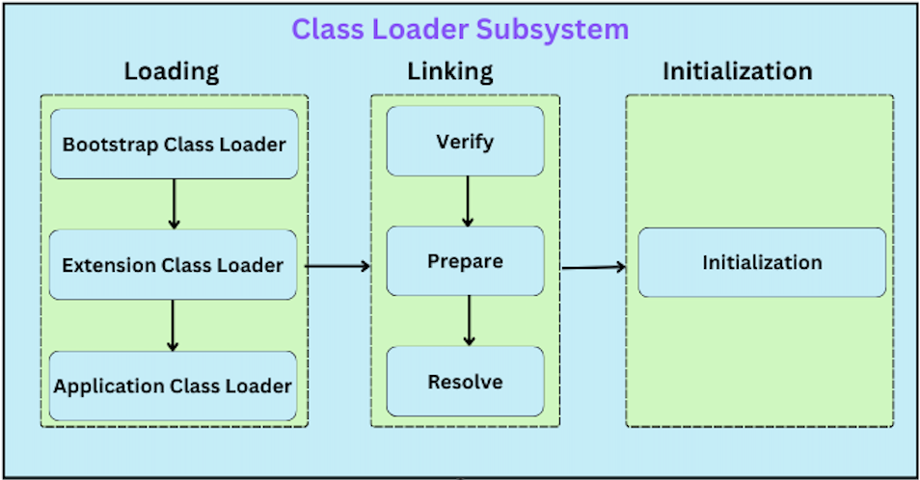
Class Loader Subsystem
Loading :- The process of reading the binary data of a class and converting it into a Java Class object in memory.
How Loading works : -
When JVM try to run .class file line by line from method area and find any Class, it will then check if that class is loaded in method area.
If not available then sends the request to Class Loader Subsystem.
This class loader works on delegation hierarchy, it means class loader will send request to Application class loader first.
Application class loader then delegates request to Extension class loader.
Extension class loader then delegates request to Bootstrap class loader.

Slide 5
This Bootstrap class loader then search the requested class in (jdk\jre\lib\rt.jar) file
If not found then delegates to Extension class loader and search the requested class in (jdk\jre\lib\ext) folder
If not found then again delegates to Application class path (Environment Variable).
If class found on any class loader then it will load the class in Method area or else throws ClassNotFound Exception.
Linking:- The process of verifying, preparing, and resolving the loaded class.
Verification: Ensuring that the bytecode adheres to Java language specifications and security constraints.
Preparation: Allocating memory for static variables and initializing them to default values.
Resolution: Converting symbolic references in the class to direct references.
Initialization: Executing the class's static initializers and static blocks.

Slide 6
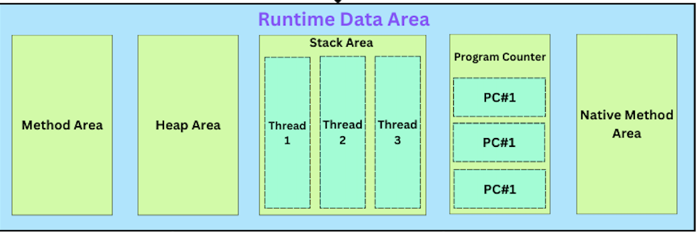
Runtime Data Area
Method Area:
It includes the fully qualified name of class/interface, its immediate superclass and modifiers of the class/interface (public abstract, final)
Contains information about all fields of a class(like modifier, type, name)
Contains information about all the methods of a class (modifier, name, return type, parameter)
Constructor information
Stores static variables and their values (as it’s class level variables)
It is shared by all threads.

Slide 7
Heap Area :
All Objects and their instance variable are stored in heap area.
Arrays and their elements are also stored in heap area.
Garbage Collector manages the heap area and destroy unreferenced/unreachable objects
When Object is created using new keywork then only memory is allocated in heap area.
Java Stack Area:
By Default main thread is already created in Stack Area and has it’s own stack.
Each thread has it’s own stack and will be destroyed once thread terminates it’s execution.
A stack is composed of stack frame. And on every method call new stack frame is pushed on top of existing stack.
Stack frame contains 3 parts i.e. Local Variable, Operand Stack, Return Address
Local Variables: Primitive data types (int, float, etc.) and references to objects.
Operand Stack: Used for intermediate calculations and operations.
Return Address: The address to return to after the method call completes

Slide 8
Program Counter Register:
Each Thread in Java Application has it’s own PC register. It is a thread specific and not shared among threads
The PC register holds the address of a bite code instruction that is currently executing.
If the current instructions executed then PC is updated to point to next instruction.
The PC is critical for managing control flow constructs in Java, such as loops, conditionals, and method calls.
It ensures that the correct instructions are executed based on the program’s logic.
Native Method Area :
Java Internally has some native methods, so when those methods calls it managed by Native Method Area
The primary function of the native method area is to facilitate the execution of native methods. When a native method is called from Java code, the JVM uses the native method stack to manage the call and its execution.

Slide 9
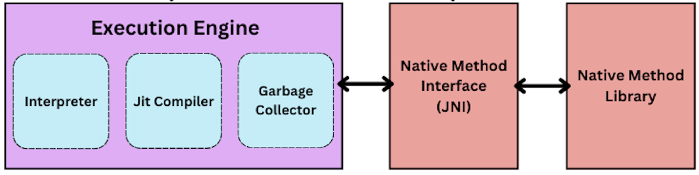
Execution Engine
Execution Engine: It translates the platform-independent bytecode into platform-specific machine code and manages the execution of this code
Interpreter: The interpreter reads and executes bytecode instructions sequentially. This is efficient for small programs or the initial execution of larger programs but can be slow for long-running applications.
Just-In-Time (JIT) Compilation:
Hotspot Detection: The JVM identifies frequently executed code paths (hotspots).
Compilation: These hotspots are compiled into native machine code by the JIT compiler.
Execution: Once compiled, the native code is executed directly, providing significant performance improvements.

Slide 10
